Slide 1

FIFA World Cup First Steps to a Predictive Model
Team 9 Consulting

Slide 2

Content
Objective
Data
Preliminary Analysis
Predictive Model Analysis
Opportunities
Conclusion

Slide 3
Introduction - Objective
T9C contracted by Shady Bookkeeping Incorporated
Data-cleaning and preliminary analysis on World Cup matches
Explore opportunities for increased yield on the investments.
Find what makes a winning team.
Analyzed team attributes, elimination round matches to 2014
Elimination stage not group stage matches analyzed
Decisive winner
Higher intensity competition
The team reviewed the data, ran a regression analysis on the chosen variables and proposed likely predictor variables for further analysis.
Notes:
Team 9 Consultants (T9C) were contracted by Shady Bookkeeping Incorporated to perform a data-cleaning and preliminary analysis on FIFA World Cup matches to explore opportunities for increased yield on their business investments. The challenge was to analyze their data to find what makes a winning team.
After considering how to best predict what determines a winning team, T9C chose to focus on a few main themes: team attributes, elimination round matches, matches up to and including the 2014 world cup. Rather than focus on the results of specific teams, T9C focused what attributes might be accurate predictors of winning.
Some of the attributes considered include but are not limited to the following:
number of wins
nationality of coach
number of cards received
team experience
T9C elected to solely consider elimination round matches as all elimination matches have a decisive winner and are therefore played at the highest level of competition. Group Stage matches do not necessarily carry the same intensity, as many factors can determine a team’s desire or necessity to win.
The team reviewed the data, ran a regression analysis on the chosen variables and proposed likely predictor variables for further analysis.

Slide 4
Data Source
Kaggle Machine Learning Data set
Dataset was provided through 3 CSV files
WorldCupMatches
WorldCupPlayers
WorldCups
Data Dictionaries were available through Kaggle

Slide 5
Data QUALITY CHALLENGES
Data Dictionary was not complete, and contained incorrect information
WorldCupMatches CSV had missing data for special win conditions
There were duplicate rows in the WorldCupPlayers file
Blank rows in the WorldCupMatches file

Slide 6
Data Preparation and Choices
We decided to only analyze elimination round matches
No ties
Highest level of competition
Decided to analyze Team Attributes, instead of Teams
E.g. There is one Brazil, but many teams with domestic coaches
Transformed the data
Each row to represent each team in a match, not each match,
Each column to represent the attributes of the team
“Events” (eg goals) were presented all in the same row, same cell,
Broke it down into different rows and columns
Events were presented at the player / match level
Aggregated goals to the team / match level

Slide 7
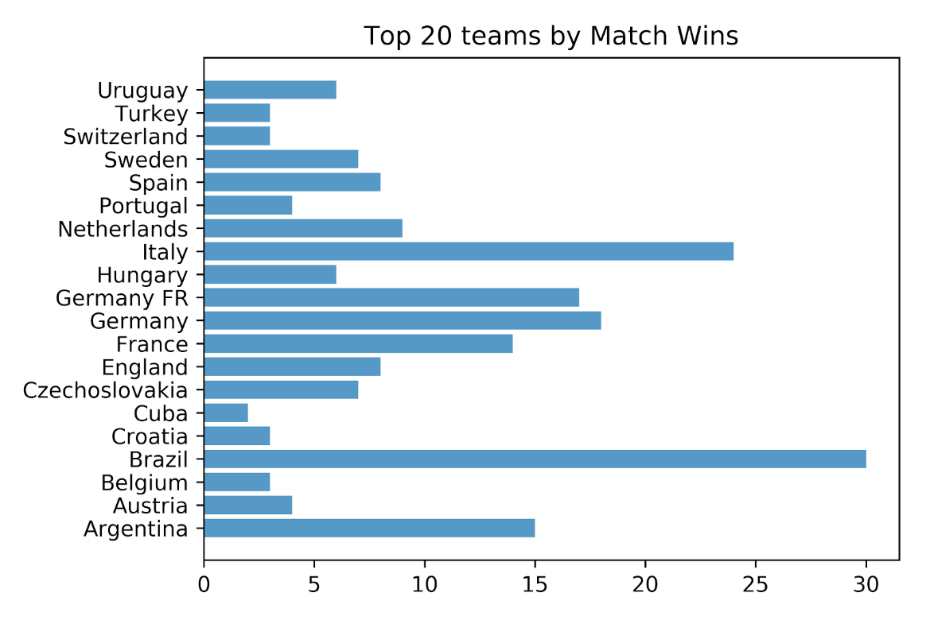
Analysis: which countries have the most knockout round wins?
Top 20 team with the highest number of knockout round wins
Including soccer giants such as Brazil, Germany, France
Croatia, runners up in 2018 world cup, only had 3 wins during knock-out rounds before this year

Slide 8
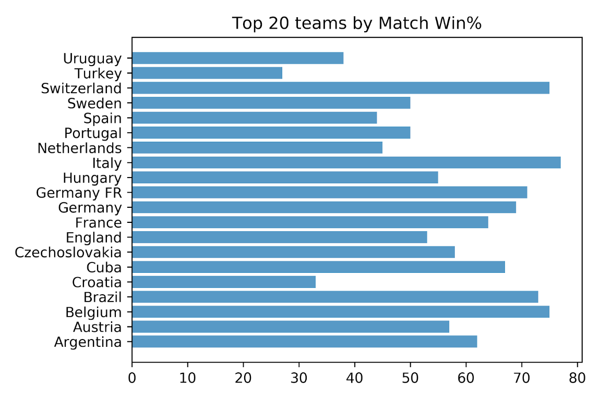
Analysis: which countries have the best Win Loss Percentage?
Top 20 teams with the highest win/loss ratio.
Powerhouses like Italy, Brazil, Germany all have good win%
Average teams like Switzerland, Cuba, Belgium also have good win %
Does not necessarily predict who is the stronger team

Slide 9
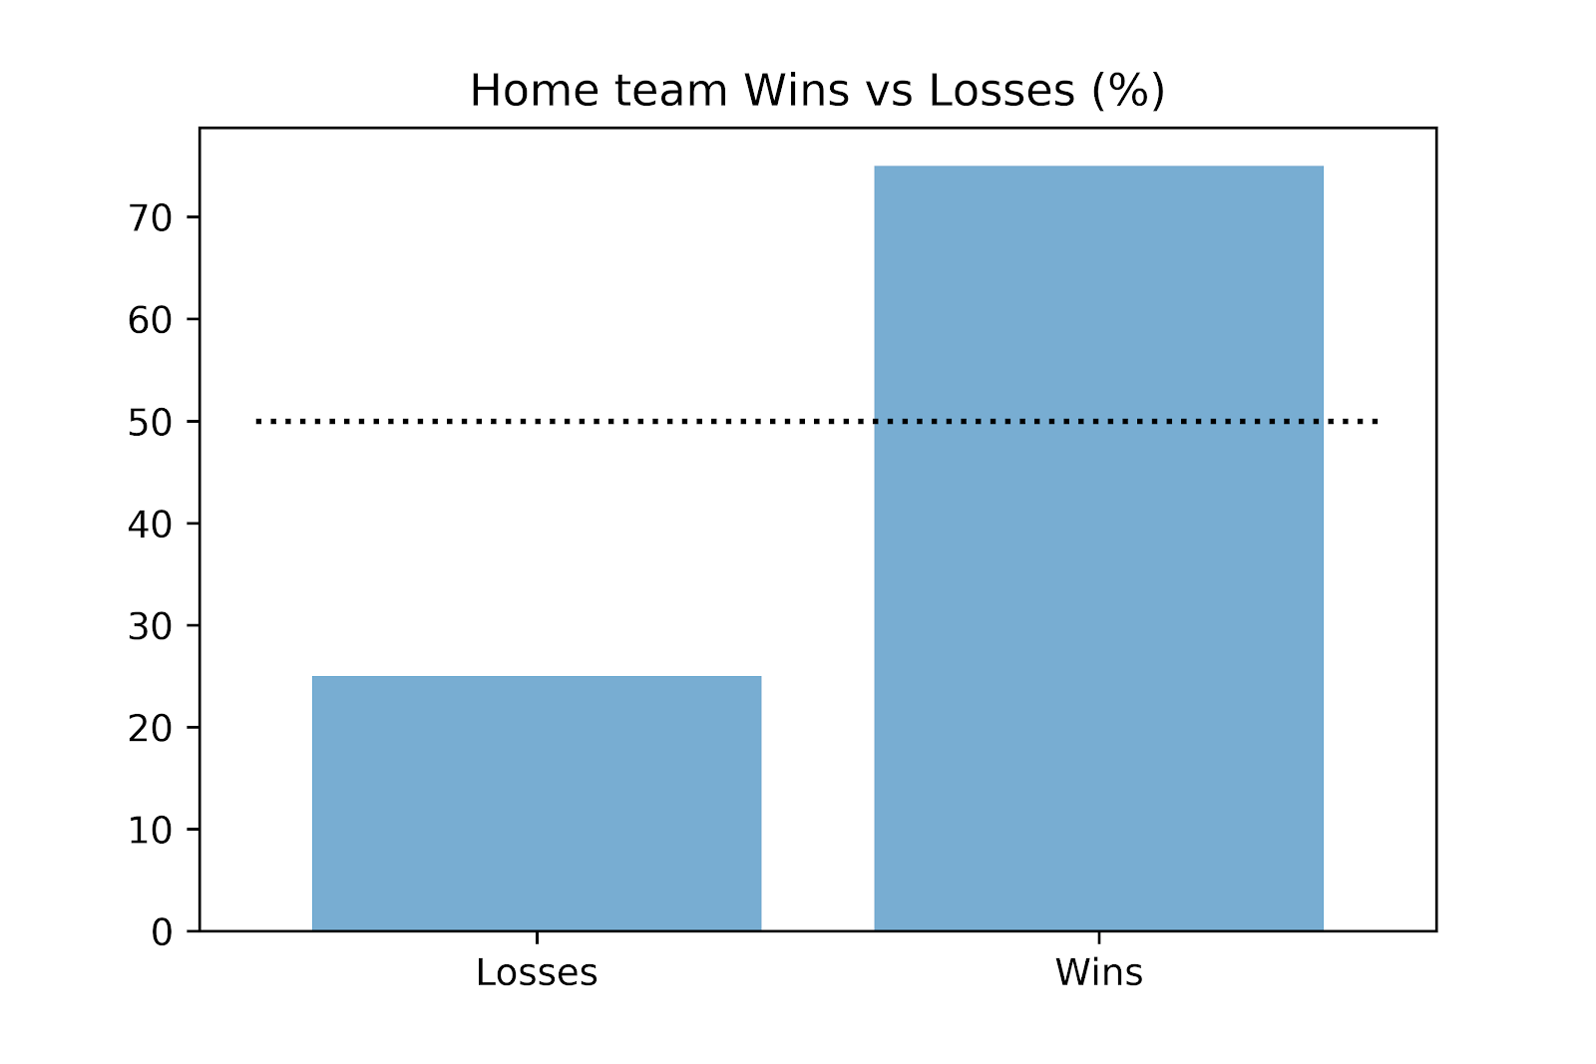
Analysis: is there an advantage being labeled the “home” team?
Yes, significant advantage for “home” team
They win over 70% of the time

Slide 10
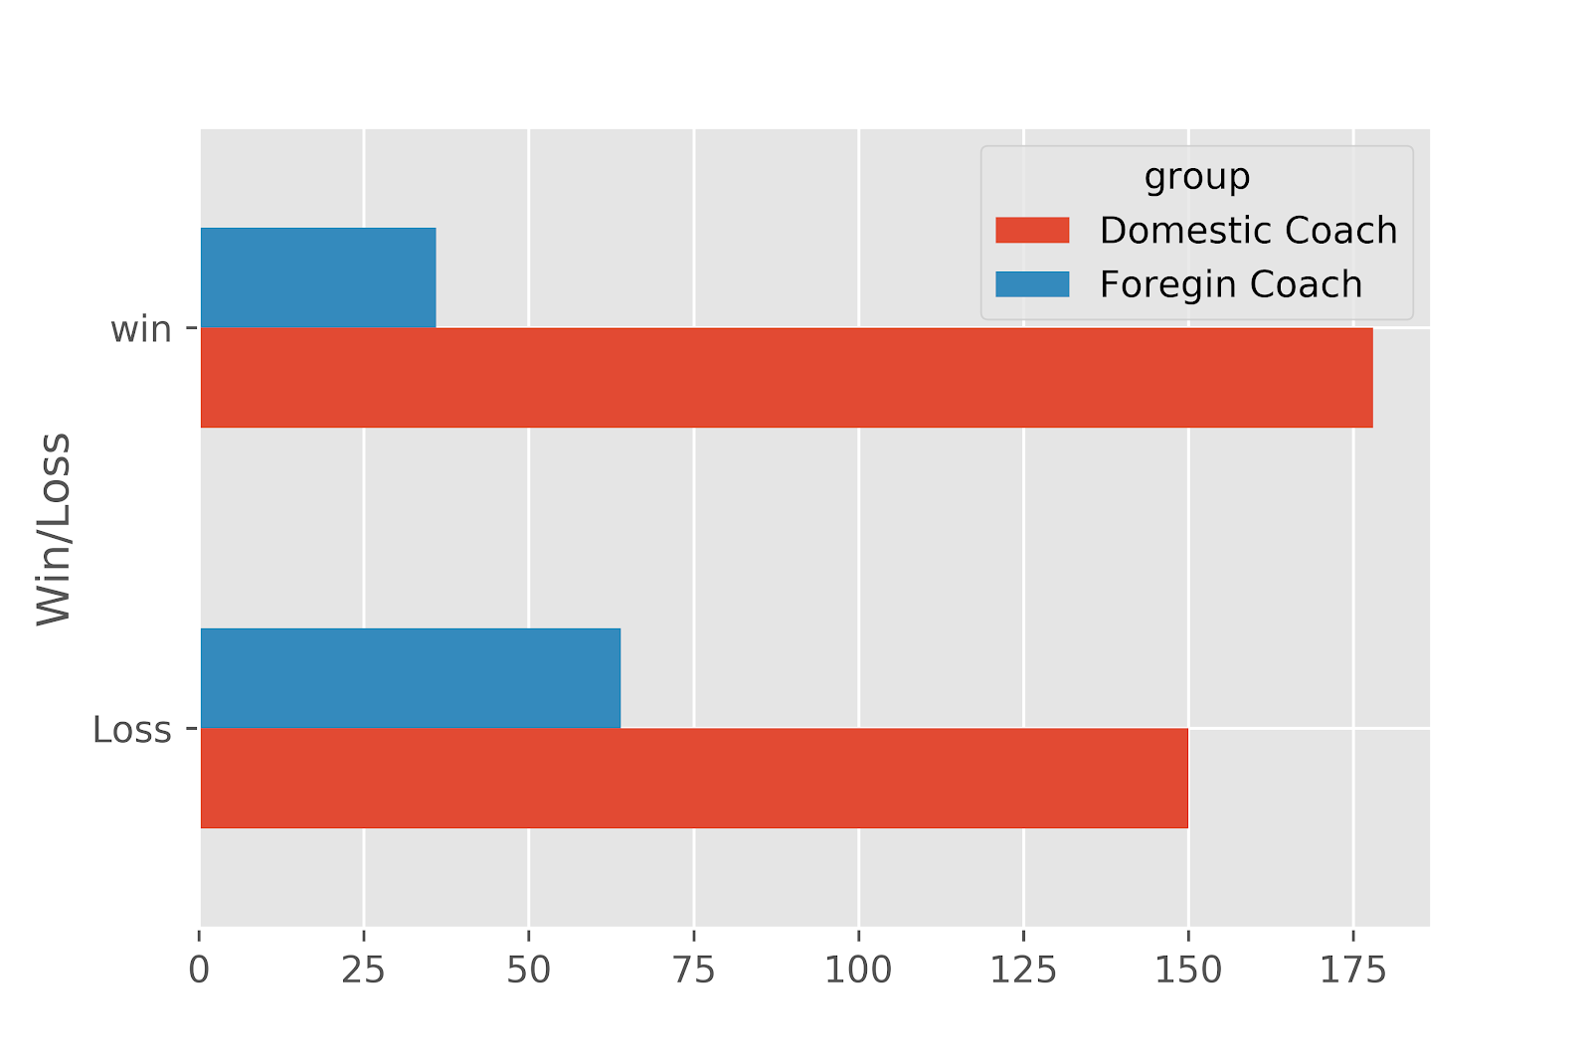
Analysis: do nationalities of the coaches affect game results?
Domestic coaches are far more common than foreign coaches
Domestic coaches win more games than they lose
Foreign coaches lose more games than they win

Slide 11
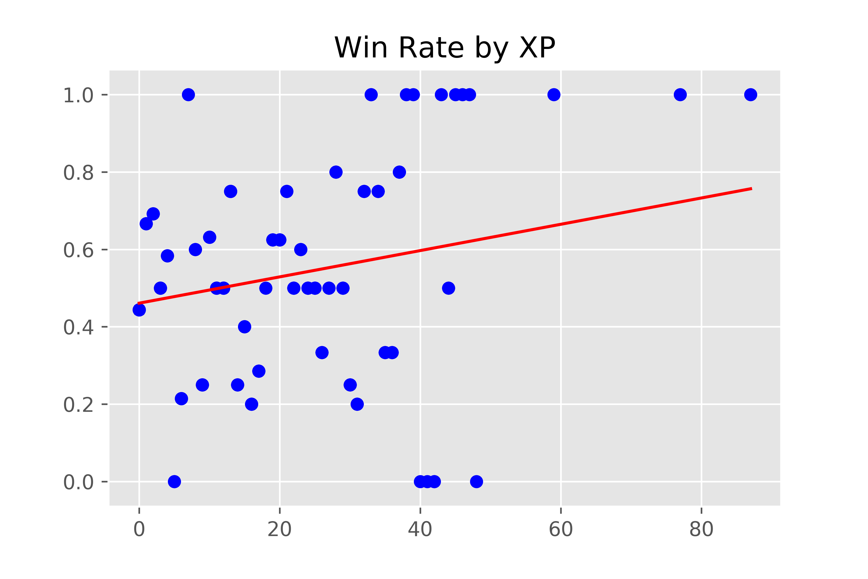
Analysis: does experience manner?
Slight trend that as the experience increases, the probability of winning also increases
Bins on the y-axis represent the groups of experience

Slide 12
Predictive Model: Logistic Regression
Two outcomes (win or loss) -> Logistic Regression
Challenges with applying a logistic regression:
Current skill set: Multivariable regression and significance testing
Correlation: The winner of a match completely determines the loser
Steps to address challenges:
Analyze the impact of variables one at a time.
Randomly choose one team per match, repeat 1000 times
Perform a logistic regression against each training set in turn.
Test each model for accuracy against the 2014 World Cup results and average.
Compare to baseline accuracy rate
A measure of the suitability of the logistic regression model for a particular variable.

Slide 13
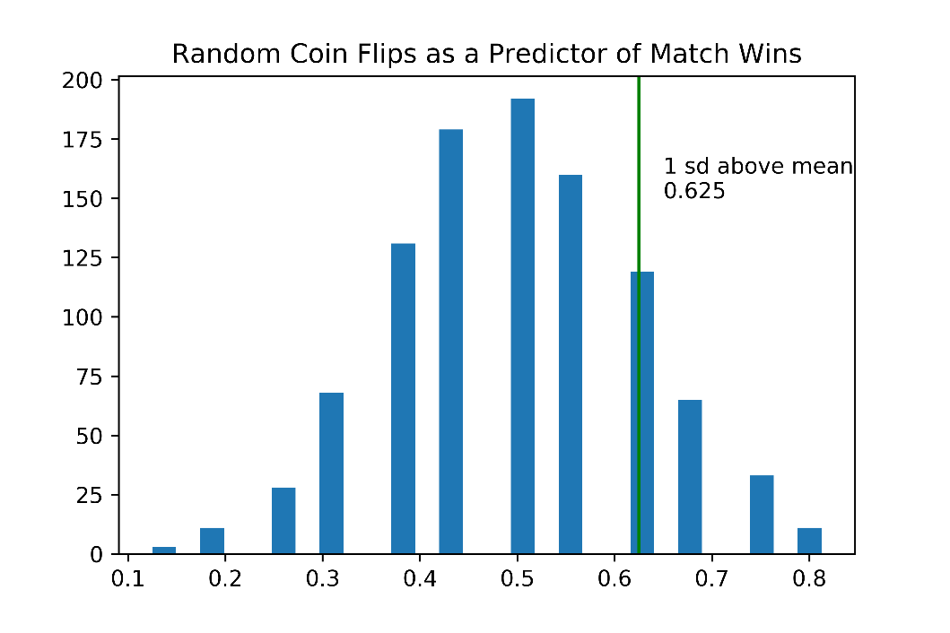
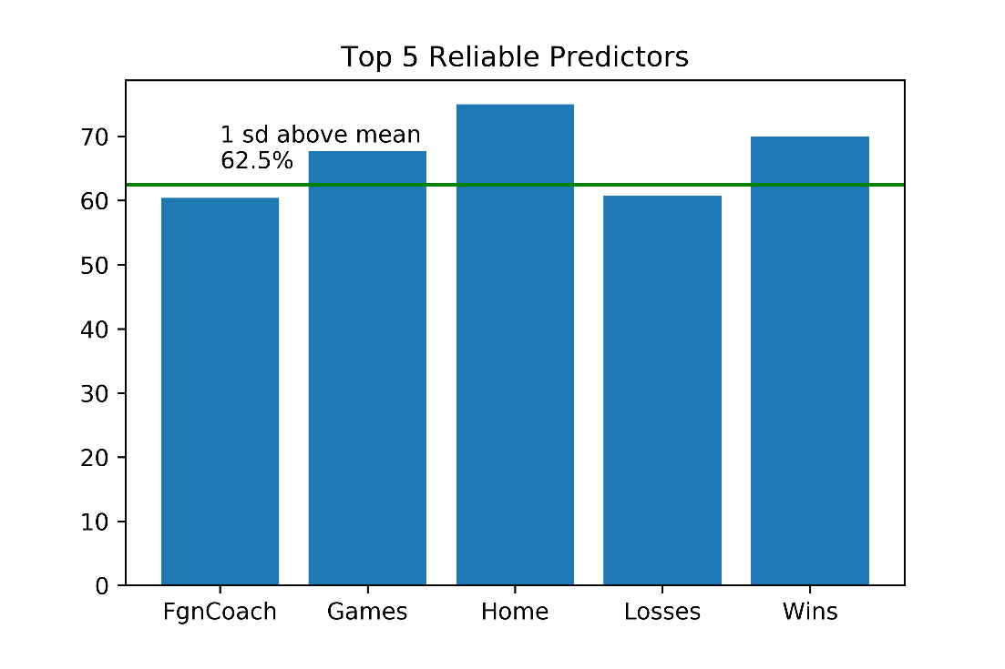
Predictive Model: Logistic Regression - Findings
16 match coin flip provides baseline
Run 1000 times to create distribution
One std dev above mean (84% conf)
Cut off rate of 0.625 (62.5%)
Modeled attribute for randomly selected team per match.
Assessed accuracy of model against 2014 result
Accuracy rates averaged for 1000 sample sets.
Average rate compared to cut off rate

Slide 14
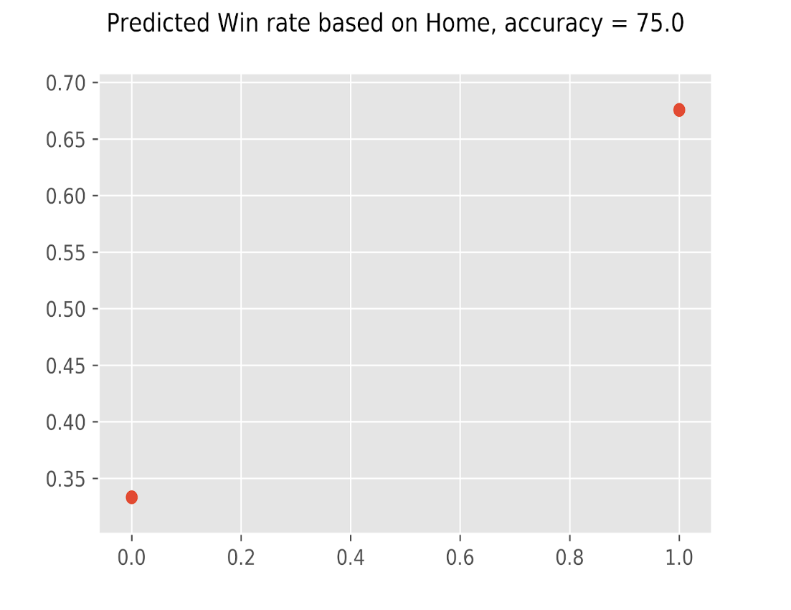
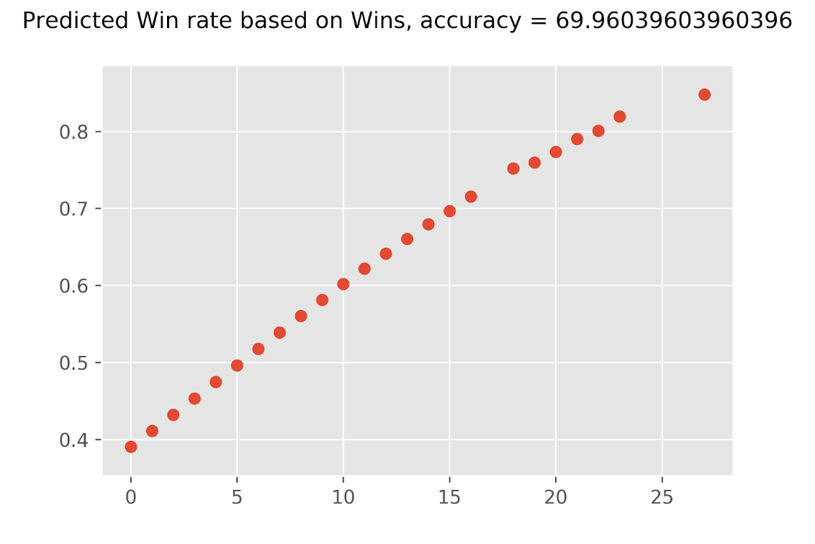
Example Models: “Home” team and Previous Wins
Home teams predicted to win
Average Model accuracy of 75%
6 or more previous match wins predict current match win
Average Model accuracy of 70%

Slide 15
Future Analysis
Perform Multivariable Logistic Regression to see the impact of severable variables at once.
For example, would a team with a foreign coach AND more than 9 previous matches in the World Cup have greater chance of winning
Perform a Clustering or Classification analysis on the data to identify cohorts and then analyze how teams from one cohort perform against teams from another cohort.
Notes:
T9C recommends the following further steps for analysis.
Including 2018 World Cup data
Including player data from league games
Analysing the head-to-head win percentages.
For instance, how likely will a team with 20 wins defeat a team with only ten wins.
Doing multivariable logistic regression over Home, Foreign Coach, Win/Loss%, and Wins
These four variables are some of the most predictive, independent variables.
Perform a Clustering or Classification analysis on the data to identify cohorts and then analyze how teams from one cohort perform against teams from another cohort
Here the analysis would answer questions like this. Suppose team A is an away team with over nine wins, a foreign coach, and a 50% win record. Suppose team B is a home team with fewer than nine wins, a domestic coach, and a 67% win record. How likely will team A defeat team B?

Slide 16
Conclusion
Best single predictor was whether the team was considered the home team.
Accurately predict the winner only 75% of the time.
Next best predictor was number of previous world cup match wins.
Single variables not sufficient to predict the outcome of a match.
Future analysis is required.

